Slide 1
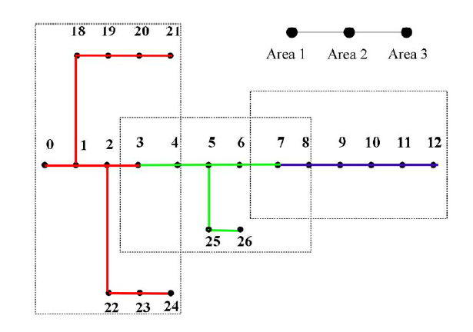
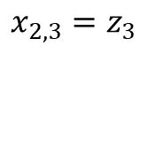
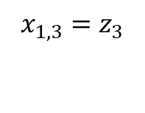
Distributed Algorithm- ADMM
x
Local copy
z
Global copy
$$x_{1,3}=z_{3}$$
$$x_{2,3}=z_{3}$$
Notes:
The distributed algorithm is based on the alternating direction method of multipliers.
suppose that the bus set supervised by area 1 is indicated by the red color, containing buses {0 ∼ 3, 18 ∼ 21, 22 ∼ 24}. However, when considering the interconnection with other areas, e.g., area 2, the bus set of area 1 must be extended to include the border of area 2, e.g., bus 4, so that the bus set of area 1 is extended
to ˆN 1 = {0 − 3, 18 − 21, 22 − 24, 4}.
For any bus j that is shared by two neighboring
areas, e.g., a and b, the local copies of state variables,
e.g., xa,j and xb,j should be all driven to the same value as
the global state variable sj.
For the system shown , we have x1,3 = s3, x2,3 = s3.

Slide 2
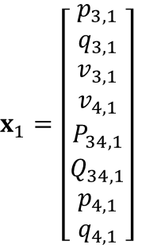
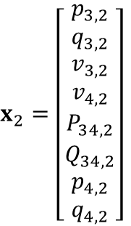
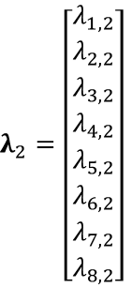
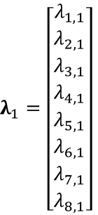
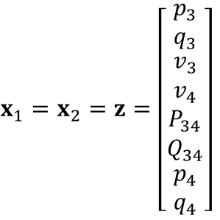
18-bus three-phase network
Area-2
Area-1
11
12
13
14
15
1
2
3
4
5
6
7
8
9
10
18
DG
16
17
Area-1
Area-2
1
2
3
4
3
4
5
. . .
$x_{1}=\left[\begin{matrix}p_{3,1} \\ q_{3,1} \\ \begin{aligned}v_{3,1} \\ v_{4,1}\end{aligned} \\ P_{34,1} \\ Q_{34,1} \\ \begin{aligned}p_{4,1} \\ q_{4,1}\end{aligned}\end{matrix}\right]$
$λ_{1}=\left[\begin{matrix}λ_{1,1} \\ λ_{2,1} \\ \begin{aligned}λ_{3,1} \\ λ_{4,1}\end{aligned} \\ λ_{5,1} \\ λ_{6,1} \\ \begin{aligned}λ_{7,1} \\ λ_{8,1}\end{aligned}\end{matrix}\right]$
$x_{2}=\left[\begin{matrix}p_{3,2} \\ q_{3,2} \\ \begin{aligned}v_{3,2} \\ v_{4,2}\end{aligned} \\ P_{34,2} \\ Q_{34,2} \\ \begin{aligned}p_{4,2} \\ q_{4,2}\end{aligned}\end{matrix}\right]$
$λ_{2}=\left[\begin{matrix}λ_{1,2} \\ λ_{2,2} \\ \begin{aligned}λ_{3,2} \\ λ_{4,2}\end{aligned} \\ λ_{5,2} \\ λ_{6,2} \\ \begin{aligned}λ_{7,2} \\ λ_{8,2}\end{aligned}\end{matrix}\right]$
$x_{1}=x_{2}=z=\left[\begin{matrix}p_{3} \\ q_{3} \\ \begin{aligned}v_{3} \\ v_{4}\end{aligned} \\ P_{34} \\ Q_{34} \\ \begin{aligned}p_{4} \\ q_{4}\end{aligned}\end{matrix}\right]$
Consensus variables between areas:
Notes:
So I started by solving on a sample 18-bus three-phase model. With linear branch flow model as the grid model, 3-phase model that considers mutual coupling.
The local boundary variables are the injection, voltage and branch flows as shown.

Slide 3
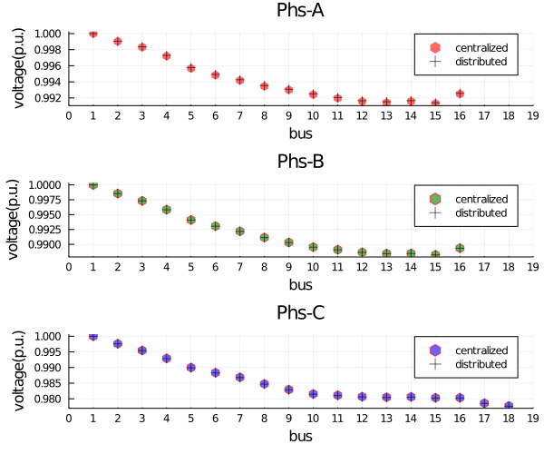
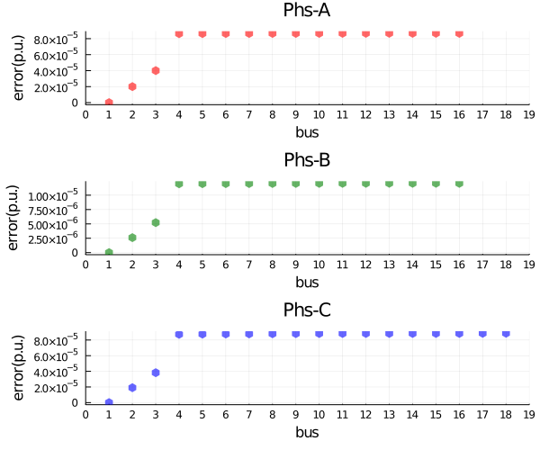
Centralized vs Distributed Voltage Profile

Slide 4
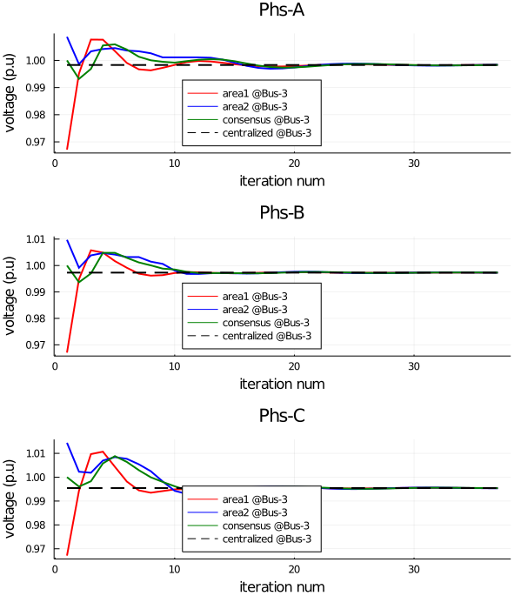
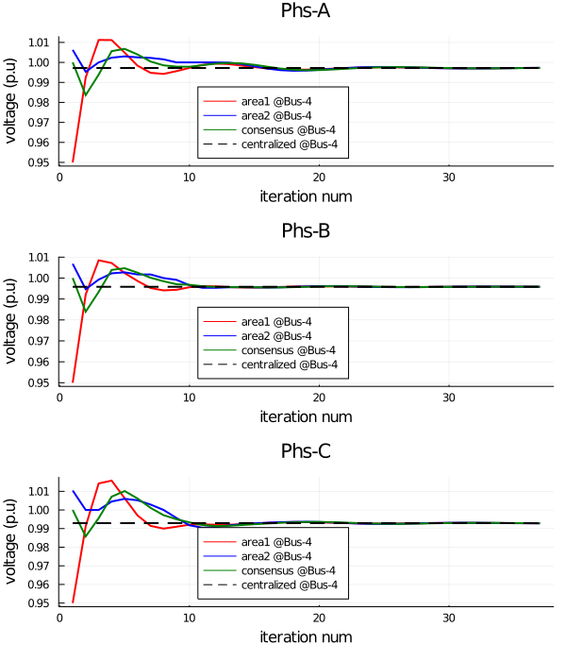
Voltage Convergence for Overlapping Area
3
4

Slide 5
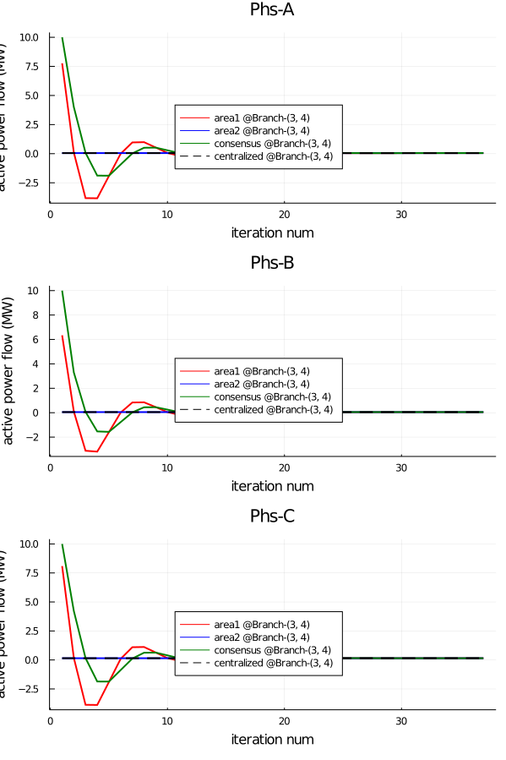
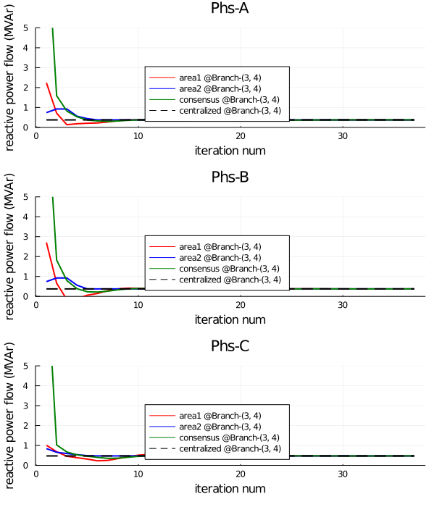
Power Flow Convergence for Overlapping Area
3
4

Slide 6
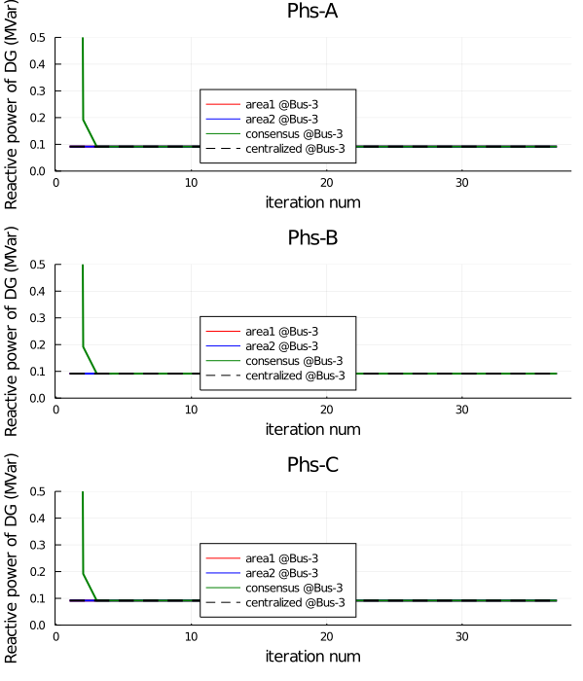
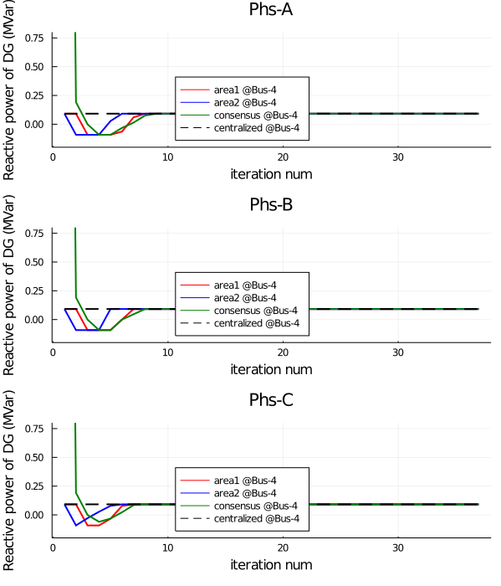
Convergence of decision variable

Slide 7

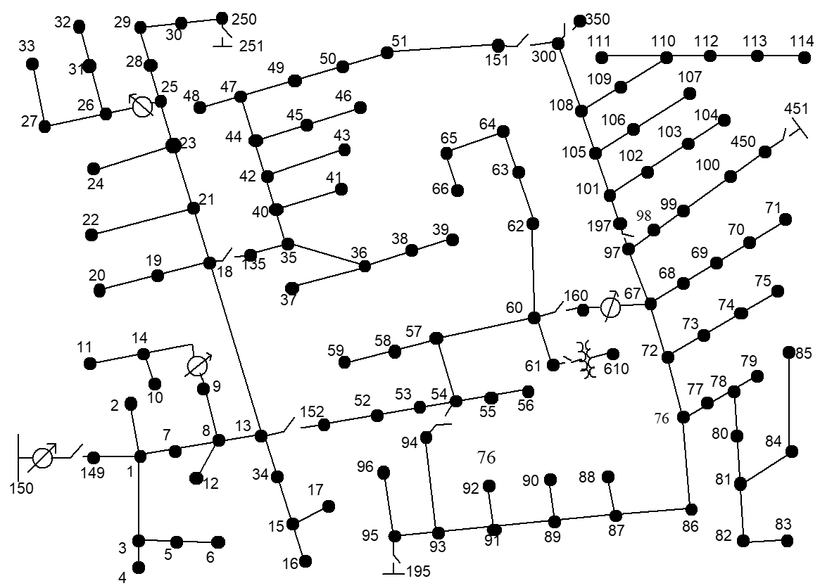
PV
IEEE-123 Node Feeder
Area-2
Area-1

Slide 8
Voltage Profile Comparison
Voltage deviation minimization

Slide 9
IEEE-123 Node Feeder
Voltage deviation minimization
MAX_ITER = 5000
 | Centralized | ρ=1 | ρ=1 | ρ=1 | ρ=10 | ρ=30 | ρ=50
Psub (kW) | 716.511 | 632.009 | 694.536 | 721.276 | 721.500 | 711.249 | 711.173
Qsub (kVAr) | -133.188 | -113.713 | -121.253 | -133.373 | -133.477 | -128.737 | -128.701
Voltage deviation (pu) | 1.332 | 1.344 | 1.344 | 1.353 | 1.353 | 1.353 | 1.353
Iteration count | - | Max=1000 | Max=2000 | 3579 | 534 | 508 | 331

Slide 10
PV curtailment minimization
 | Centralized | ρ=1 | ρ=1 | ρ=1 | ρ=10 | ρ=30 | ρ=50
Psub (kW) | -119.743
Qsub (kVAr) | 61.038
Pdg curtailment (pu) | 759.543
Iteration count | -

Slide 11
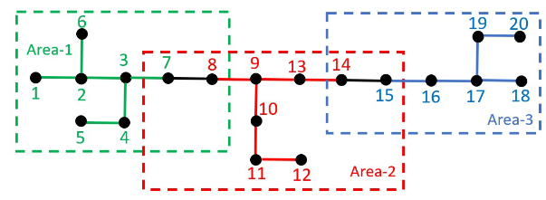
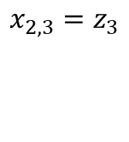
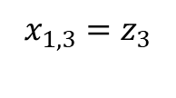
Distributed Algorithm- ADMM
x
Local copy
z
Global copy
$$x_{1,3}=z_{3}$$
$$x_{2,3}=z_{3}$$
Notes:
The distributed algorithm is based on the alternating direction method of multipliers.
suppose that the bus set supervised by area 1 is indicated by the red color, containing buses {0 ∼ 3, 18 ∼ 21, 22 ∼ 24}. However, when considering the interconnection with other areas, e.g., area 2, the bus set of area 1 must be extended to include the border of area 2, e.g., bus 4, so that the bus set of area 1 is extended
to ˆN 1 = {0 − 3, 18 − 21, 22 − 24, 4}.
For any bus j that is shared by two neighboring
areas, e.g., a and b, the local copies of state variables,
e.g., xa,j and xb,j should be all driven to the same value as
the global state variable sj.
For the system shown , we have x1,3 = s3, x2,3 = s3.

Slide 12
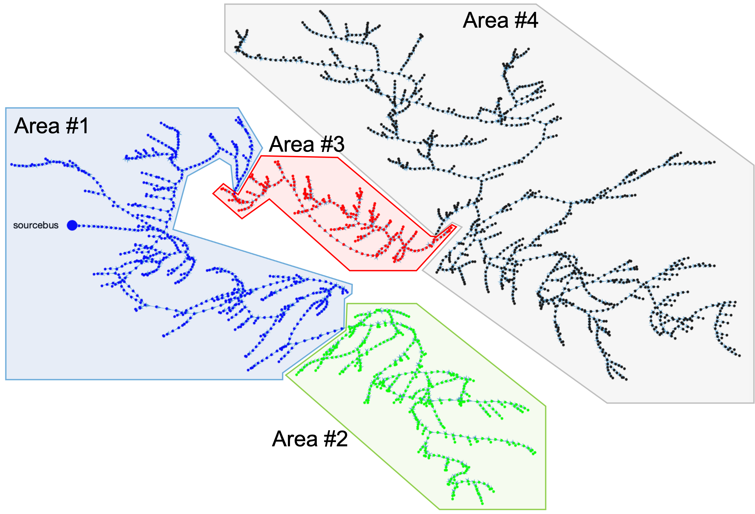
2500-bus system

Slide 13
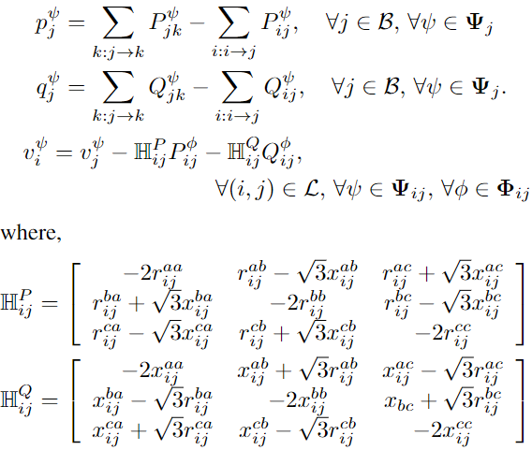
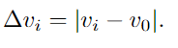
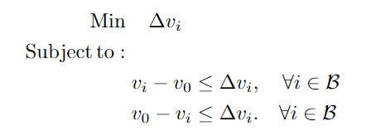
LinDist3flow
Voltage deviation minimization

Slide 14
Voltage Profile Comparison

Slide 15
2500-bus system
Area 4
Area 1
Area 3
Area 2

